Slide 1
Week 7 07/07/2026

Slide 2
Pick Up From Week 4 –06/09/2026
•Investigate whether one Select and Operate transaction contain multiple CROBs ?

Slide 3
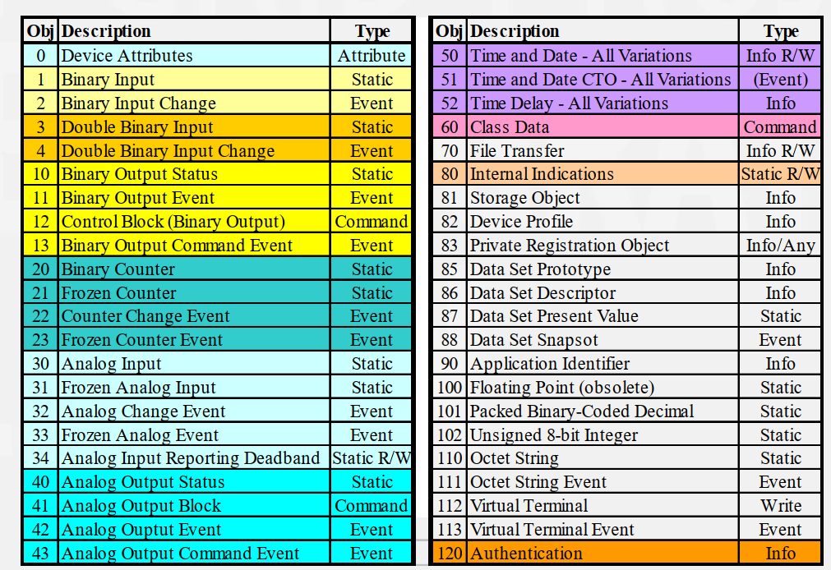
Reading 1
Andrew West DNP3 Presentation -2020
Chair, DNP Technical Committee
What it clarified
Function code
SELECT / OPERATE
Object
G12V1 CROB
• SELECT and OPERATE are application function codes.
• CROB is Group 12 Variation 1.
• The index is the target output point.
• The control code is the operation, such as LATCH_ON or LATCH_OFF.
How I used it
• Validated one object header with count N.
• Checked per-index command status in SELECT and OPERATE responses.
• Used Wireshark/PCAP evidence instead of assuming the API behavior.

Slide 4
DNP3 Control Model
• The master first SELECTs the control objects.
• The outstation accepts or rejects each selected object.
• The master OPERATEs only if SELECT succeeds
Master
Outstation
SELECT
G12V1 CROBs
RESPONSE
status per CROB
OPERATE
same CROBs
RESPONSE
execute status

Slide 5
One Object Header, Many CROBs
• Each CROB does not need its own full object header.
• One Group 12 Variation 1 header can carry a counted list of indexed CROBs.
• The qualifier tells the parser how the objects are indexed.
• The count tells the outstation how many CROB entries follow.
Object Header
Group 12
Var 1
Qualifier 0x28
Count = N
CROB 0
index 0 · LATCH_ON
CROB 1
index 1 · LATCH_OFF
CROB N-1
index N-1
...
• if the objects are not the same type/format, you need a separate object header for each different set of objects. i.e If Objects share the same Group, Variations and Qualifier.

Slide 6
Experiments
Experiments | Number of CROB
A | Index 0 : Latch ON | Normal Select and Operate
B | Index 1: Latch OFF | Normal Select and Operate
C | Index 0 :Latch ON Index 1 :Latch OFF | 2 CROBs carried in one transaction
D | Even Indexes :Latch ON Odd Indexes : Latch OFF | To determine the largest index where failure occurs (Nmax)
We defined the simulated points and requested CROBs in Python, but OpenDNP3 constructs the DNP3 Group 12 Variation 1 object header, qualifier, count, SELECT/OPERATE messages, and response processing.

Slide 7
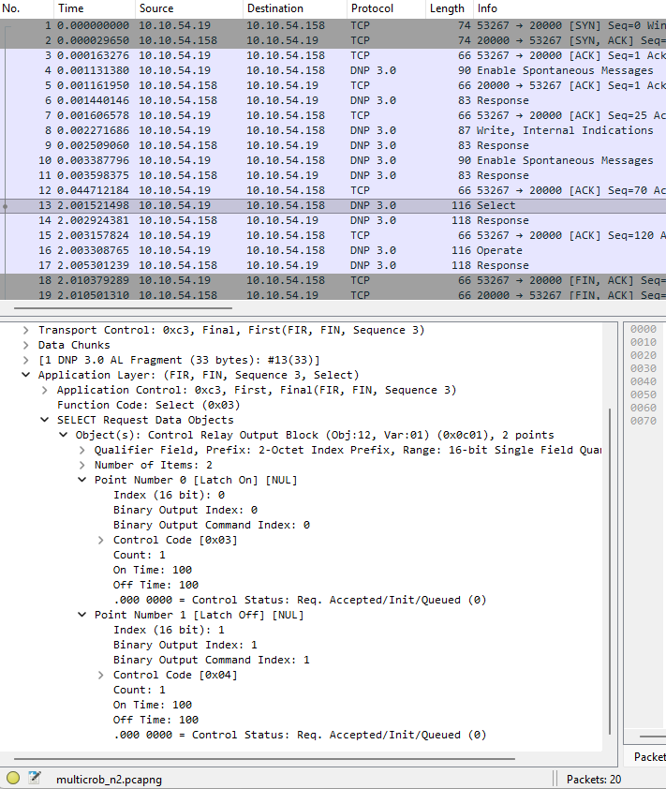
Does it work? Yes!
Count =2
SBO transaction works
Latch ON and OFF sent

Slide 8
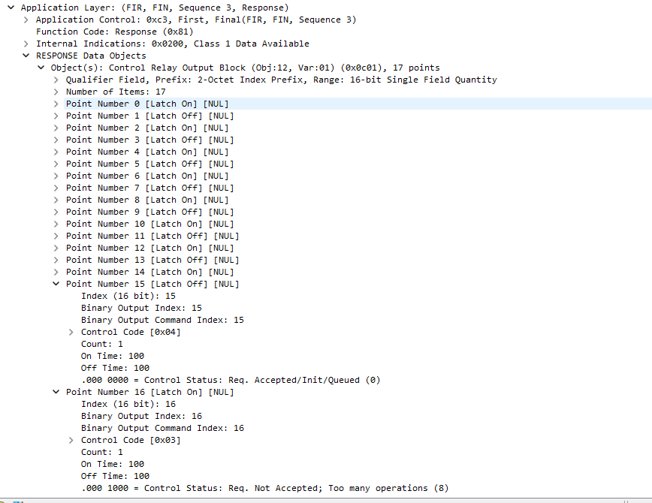
How many Multiple CROB’s can DNP3 handle? - Nmax
At Count = 17, Index 16 req is not accepted
It carries Group 12 Variation 1, qualifier 0x28, Count = 17.
• The outstation response accepts indexes 0–15.
• The seventeenth CROB, index 16, returns TOO_MANY_OPS.
• Because SELECT did not fully succeed, the master sends no OPERATE.

Slide 9
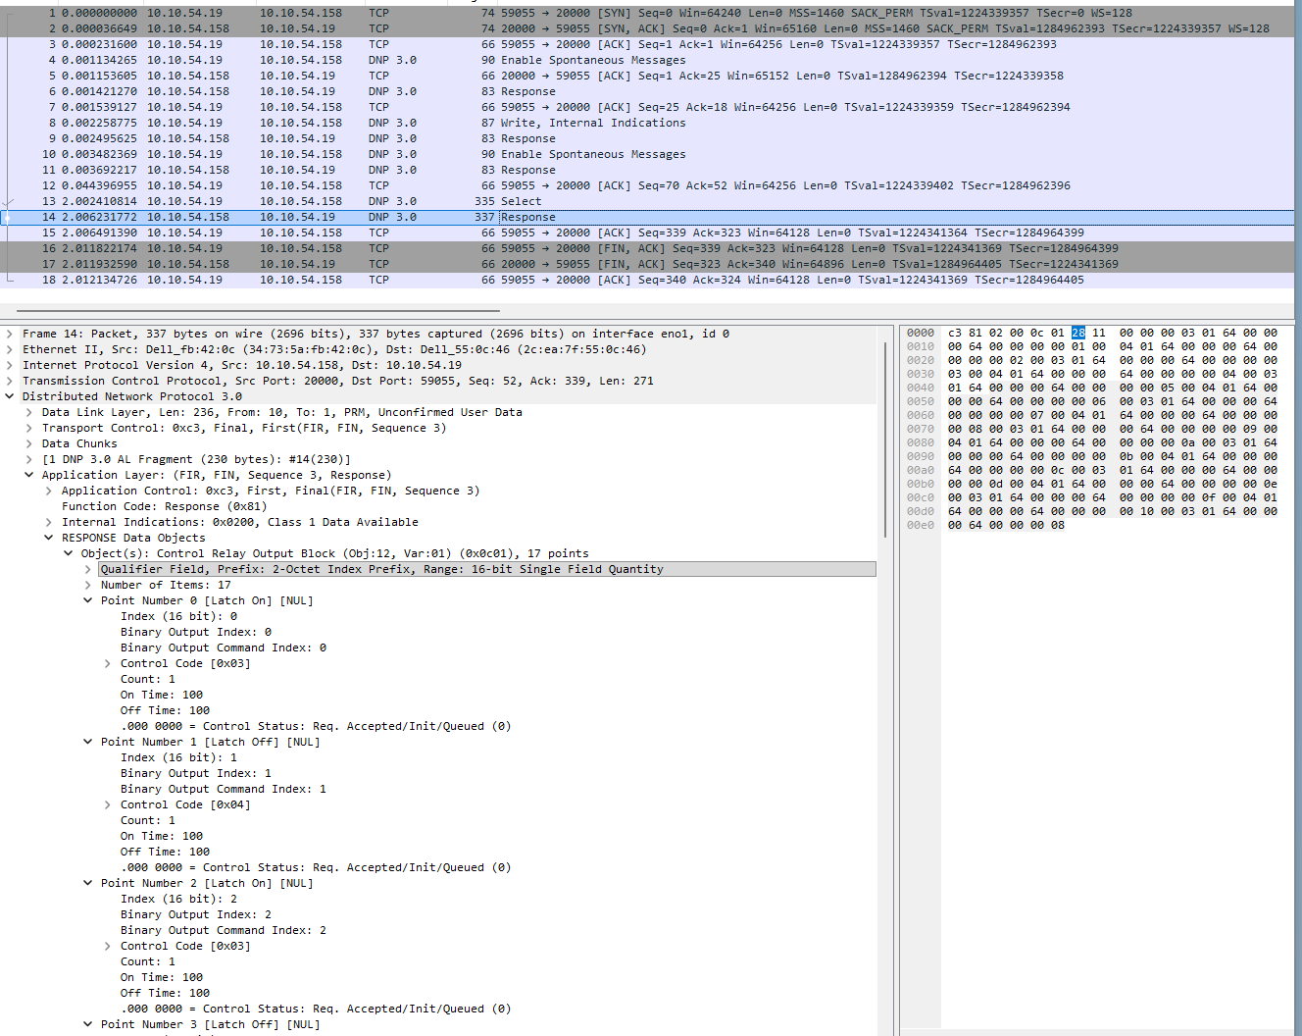

Slide 10
Question/ Next Steps
Use multiple Groups and Variations in headers that will lead to multi-objects – Mixed object header.

